Slide 1
Amplifying Impact through Workplace Giving

Slide 2
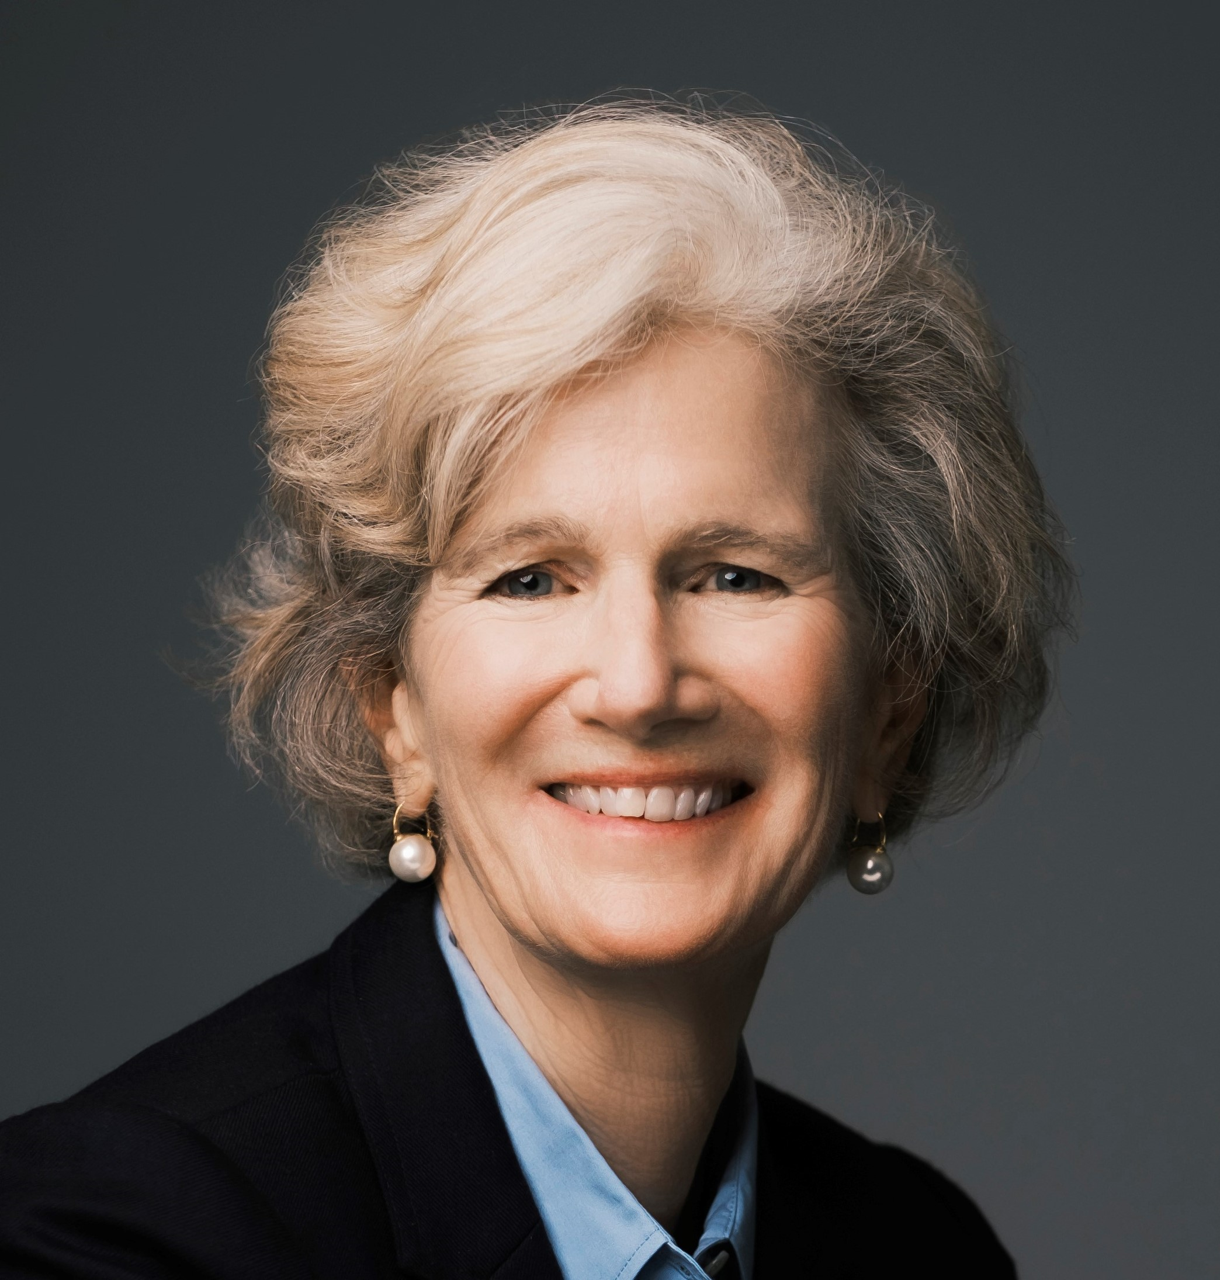
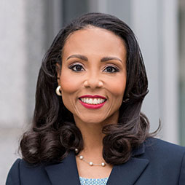
Our Panel
Elizabeth Marenakos
Director of Product Marketing and Value Enablement, Blackbaud
Board Member
The Blackbaud Giving Fund
Tycely Williams
Chief Development Officer Bipartisan Policy Center
Board Member
The Blackbaud Giving Fund
Calli Hartman
Head of Customer Success
Blackbaud Corporate Impact

Slide 3
Workplace giving amplifies giving -
> 30 million
> 40%
$1,248
Corporate Employees
have access to
workplace giving programs
Proportion of
total donations from
company match
Average annual
employee donation – including company match
Notes:
Corporate Foundation Giving can equal giving from employees and the company match
Do we want to show the stat of what % of company match $$ go back into the coffer each year?

Slide 4
Topics for Today
Anatomy of a CSR program
Employee Involvement
Donor Advised Fund as a delivery vehicle
Effective Stewardship at the Nonprofit

Slide 5
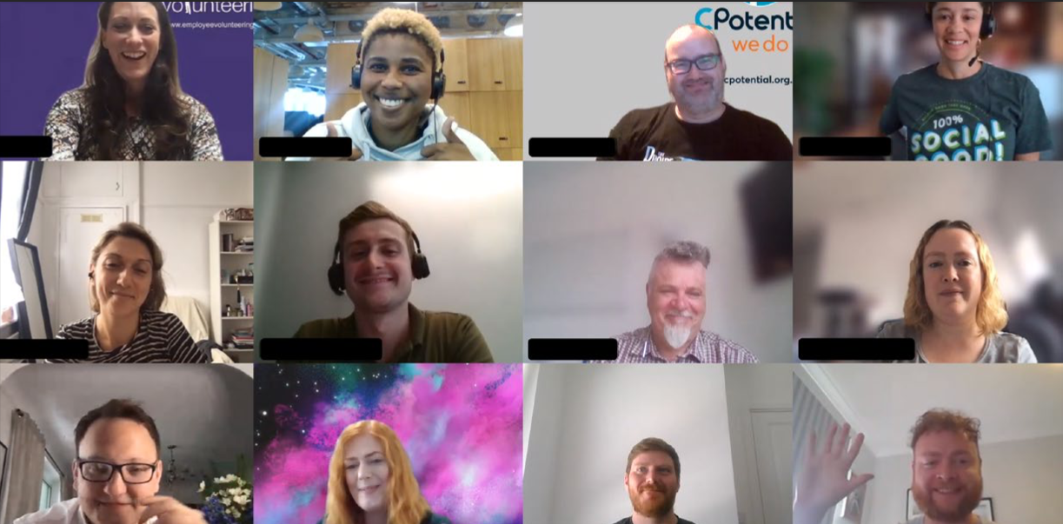
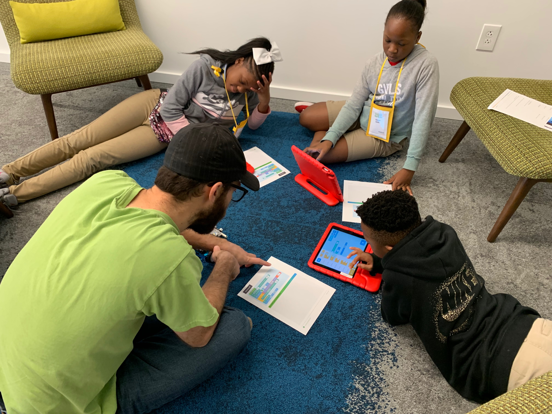
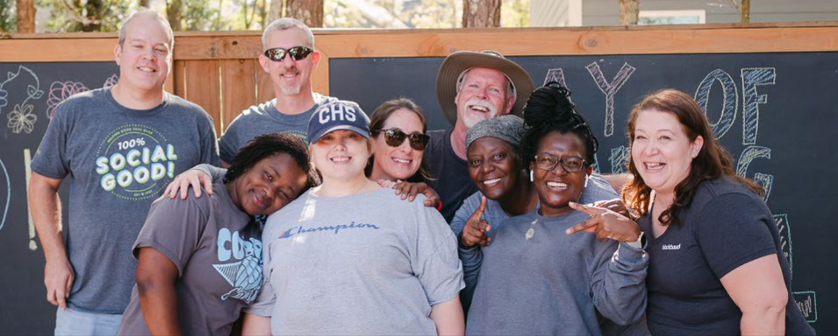
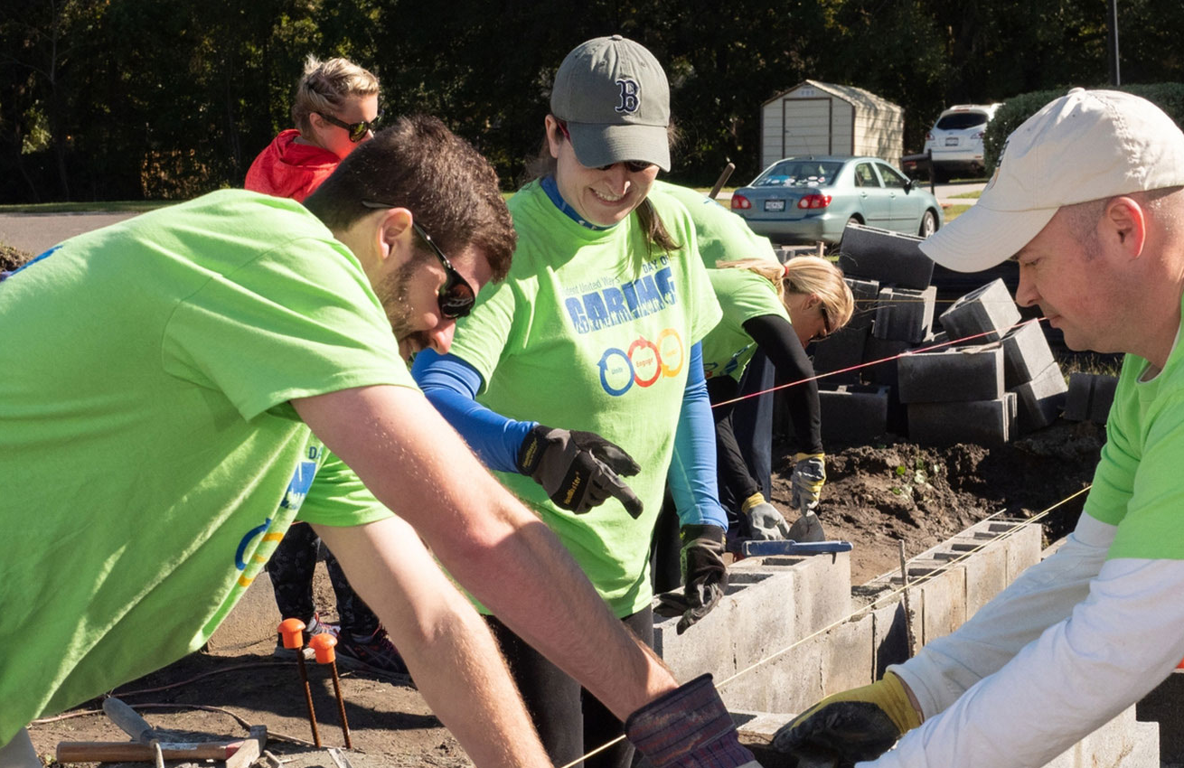
Anatomy of a CSR Program
Notes:
Looking for how corps set up their CSR programs and the connection to the NPOs, How do employees learn about NPOs? Do corporations partner with NPOs? What are corporations looking for when they choose NPOs for employee giving, foundation giving? How do they get employees engaged. The role of volunteering vs giving.

Slide 6
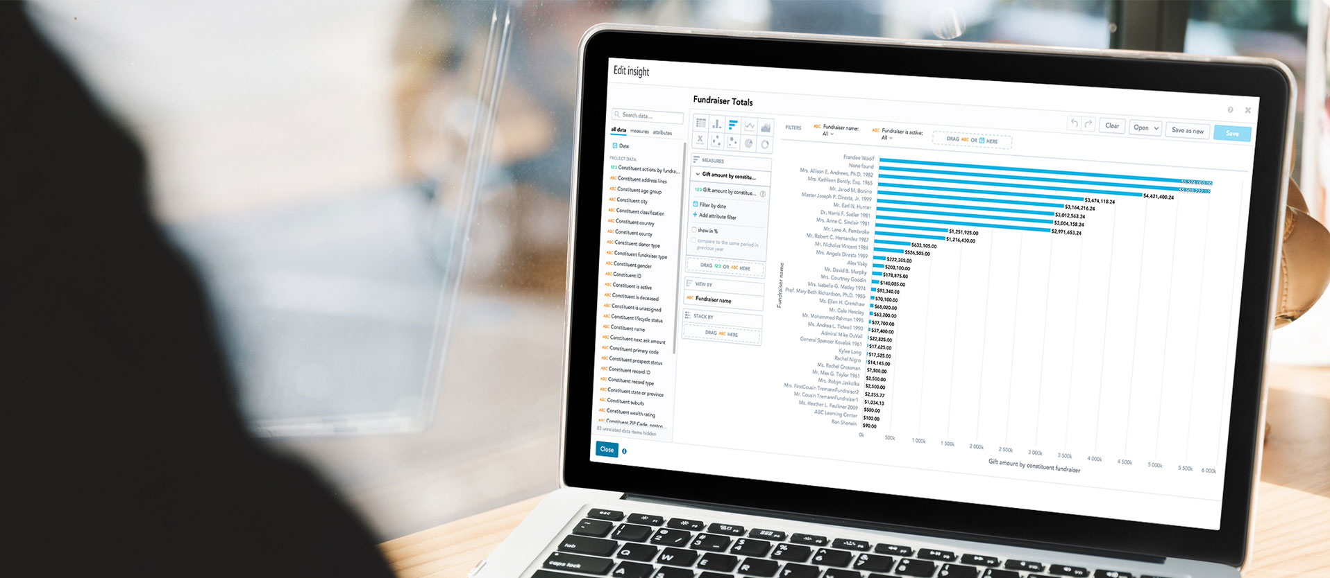
Stewardship of Workplace Donors
Notes:
Tycely’s slide:
How nonprofits track workplace giving ( employees and corporate foundation), development strategy, partnership strategy with corporations, growth strategy. Looking at the process from the mirror image of the corporate CSR program.

Slide 7
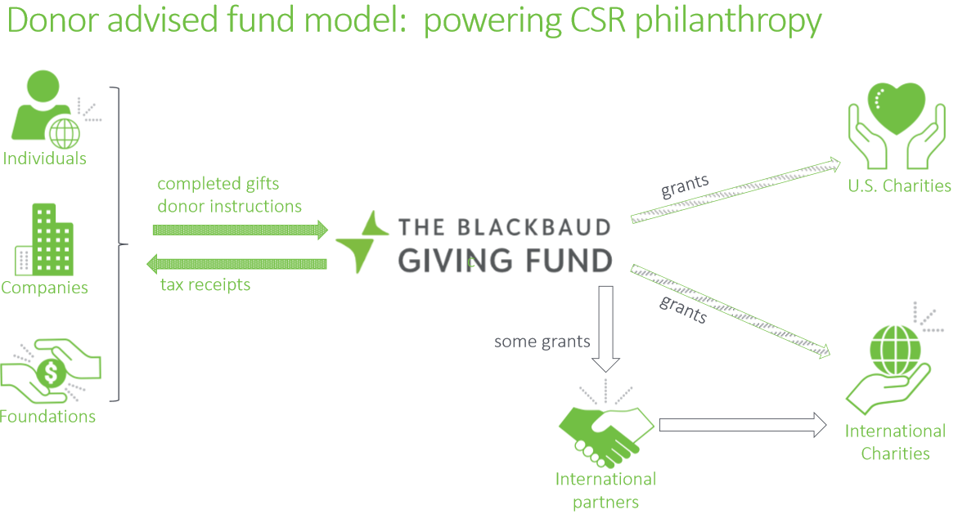
The Role of the Donor Advised Fund

Slide 8
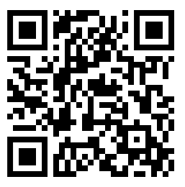
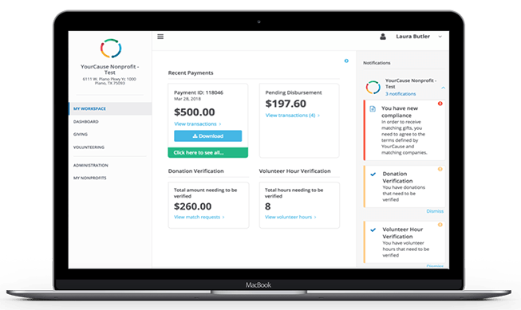
Register for NPOconnect!
Connect your nonprofit to the Blackbaud Giving Fund,
and the companies who use CSRconnect and GrantsConnect.
nonprofit.yourcause.com
Get Payments Faster – register for ACH to receive donations electronically, up to 3 weeks quicker than by check.
Boost your Image – communicate your organization’s presence, mission, and goals. Update your logo, search tags, website, address and more.
Workspace – Get a quick overview of recent donations, pending donations, and volunteer and gift verifications
Stay Up-to-Date – Notification emails keep you informed of any important actions you need to take, including verifying donations and hours to unlock additional corporate matches.

Slide 9
Panel Summary Points

